Slide 1

Baby Monitoring Device.
Moshiour Rahman Prince
Interactive System Enginnering
Electronic Enginnering

Slide 2

Agenda
Monitor vital sign
Detect changes
Notification
User Interface

Slide 3

01
Concept
Heart Rate
Sp02
Sleep patterns
Breath

Slide 4
01
Research

Slide 5
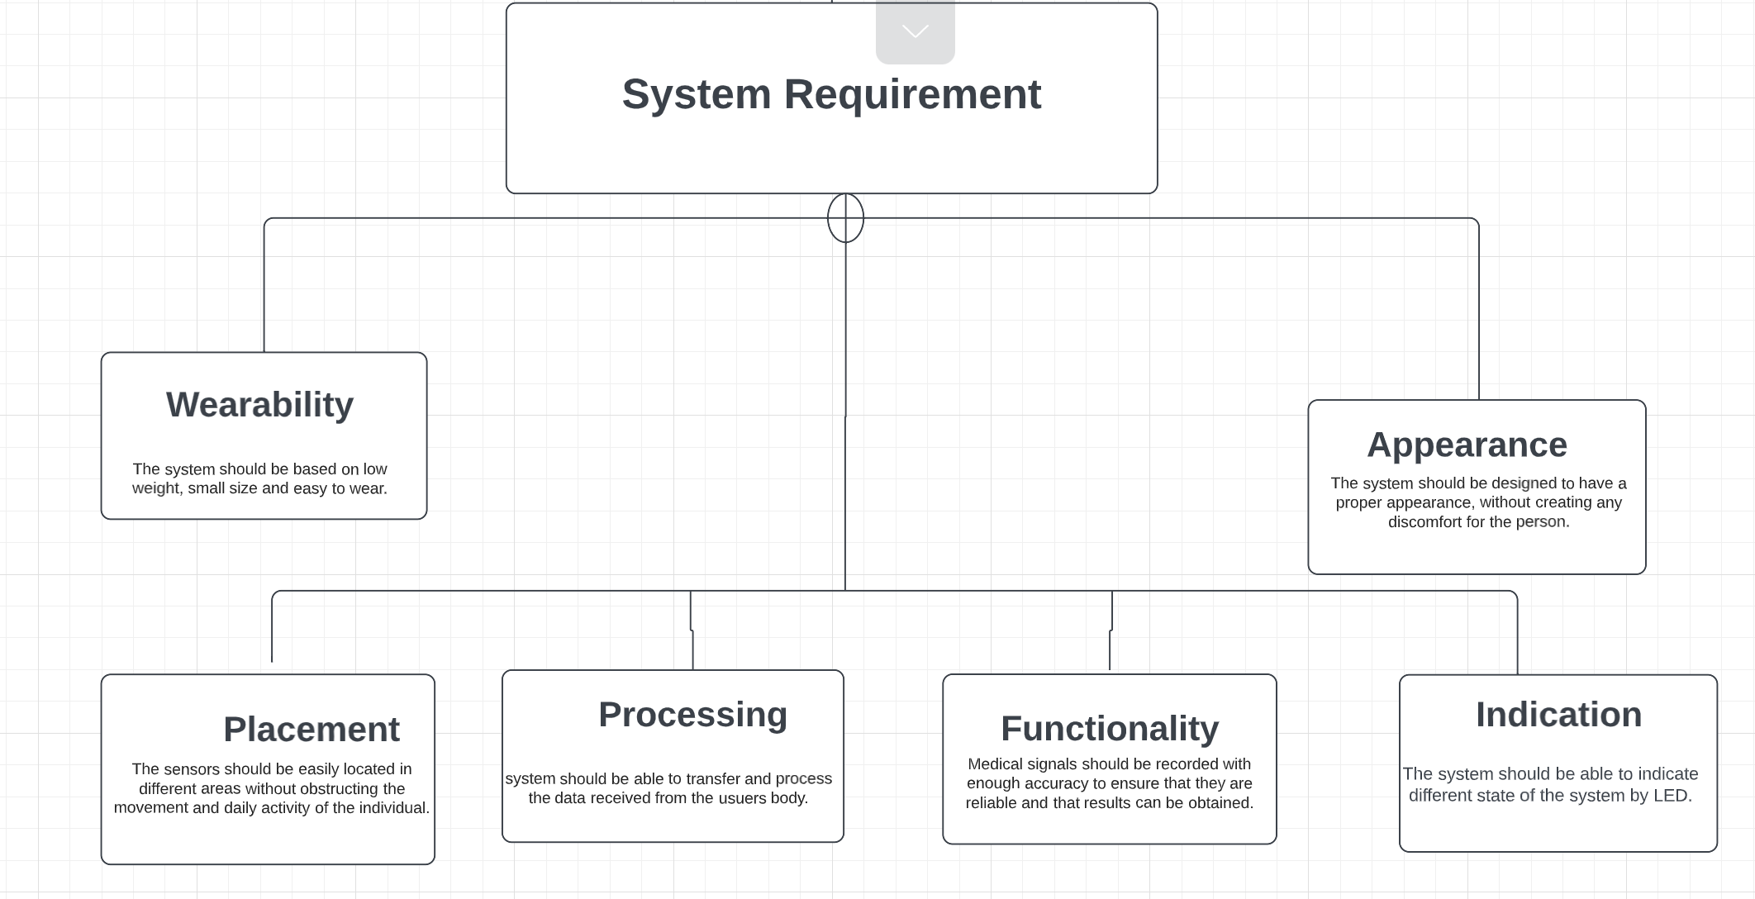
01
System Model

Slide 6
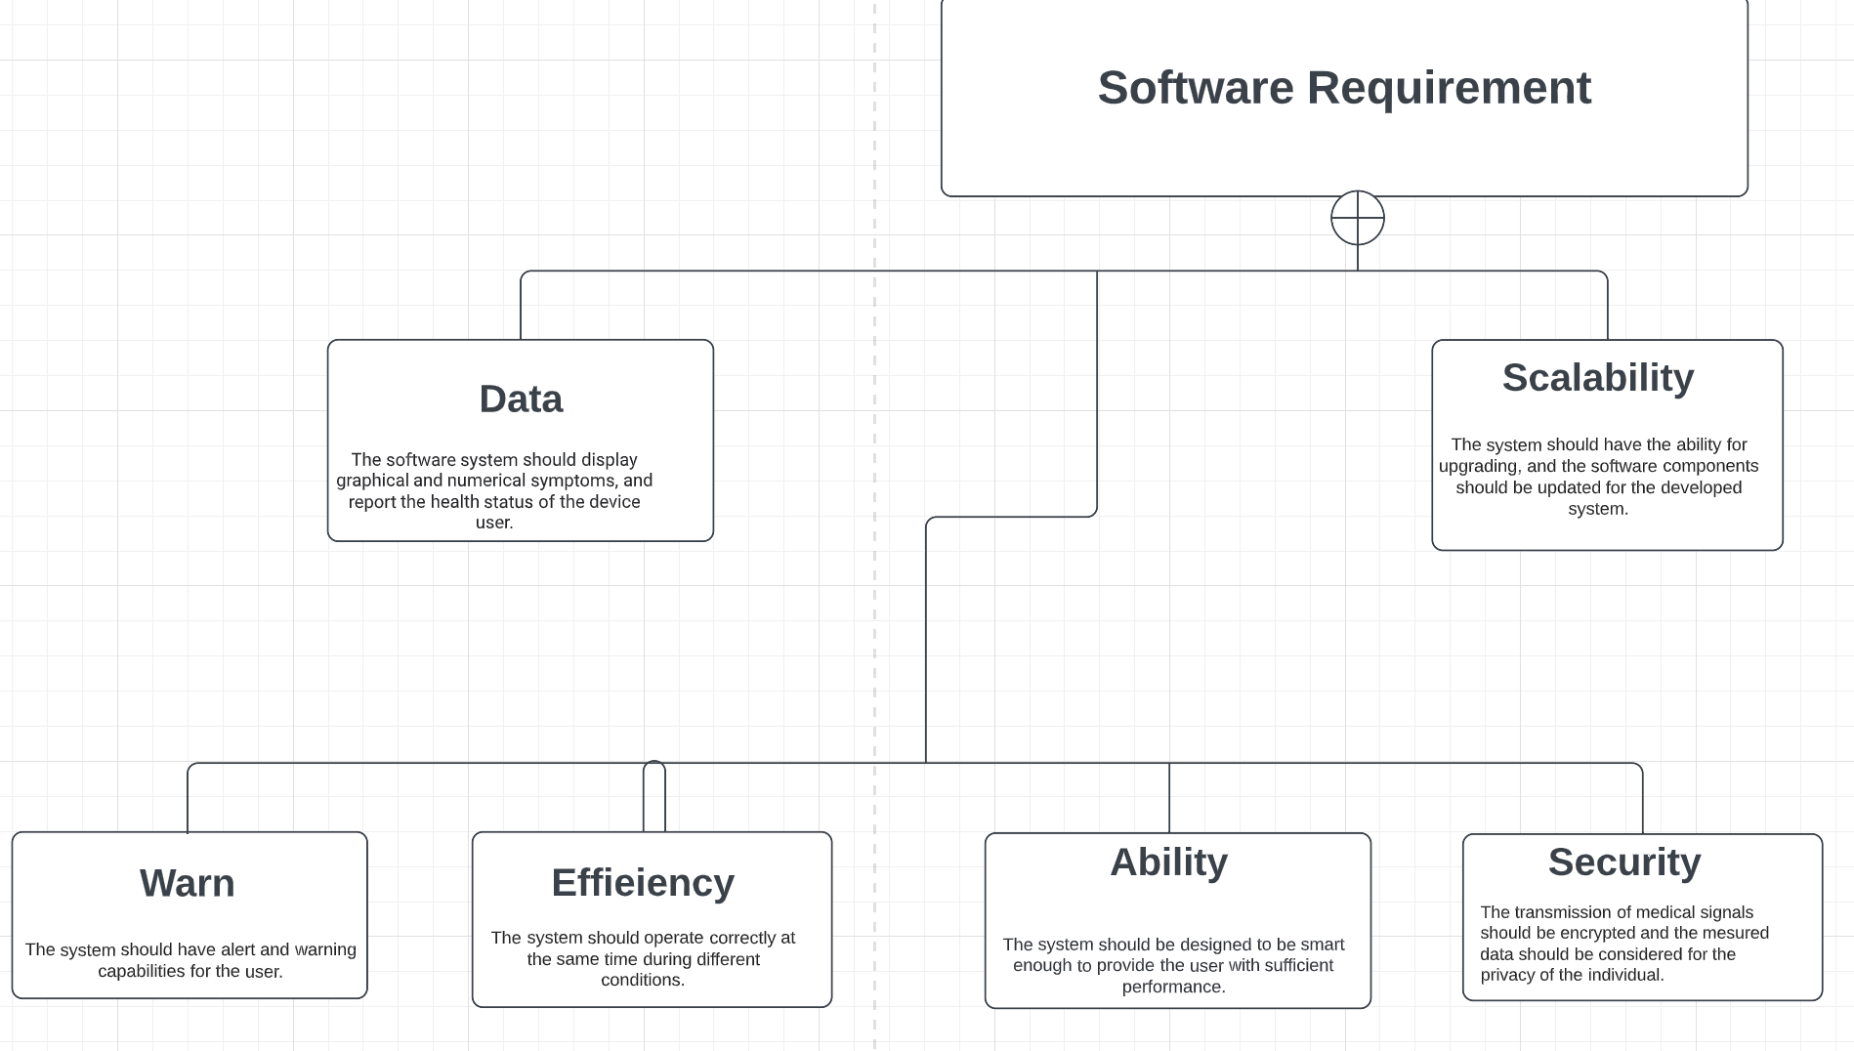
01

Slide 7
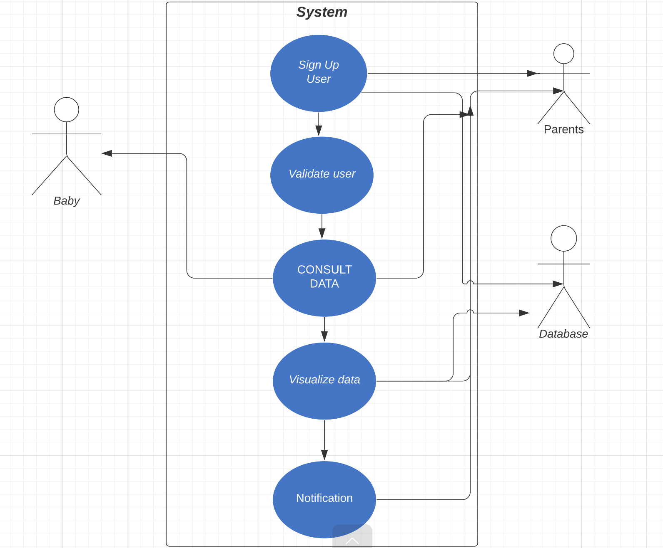

Slide 8

Hardware Specification
Microcontroller
Sensor
Battery
Charging Plate
Medical Fabric
https://github.com/moshiour-rahman/SS2022-ELE-Interactive-Systems-Engineering

Slide 9
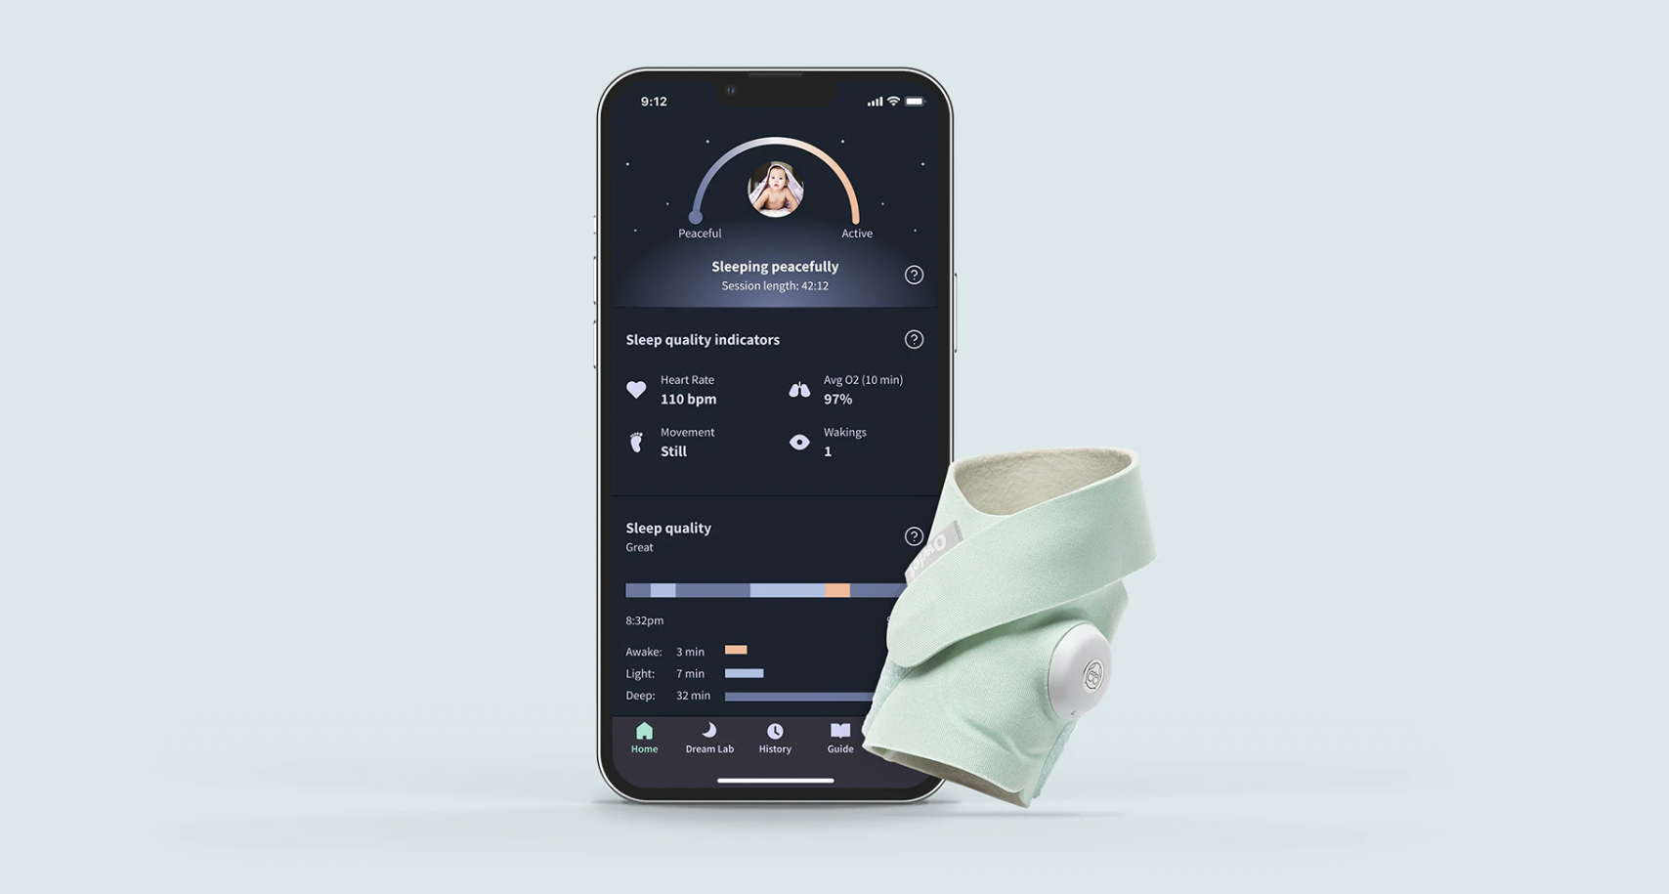
User Interface
https://www.owletcare.com/products/owlet-dream

Slide 10
Thank you.

